Slide 1
Consultative
Decision Making Exercise

Slide 2
Practice Consultative Decision Making

Slide 3
Role Play:
Non-Consultative
Planning a
Work Party
Notes:
Small groups (comic book groups).
Hand out bad behaviour slips
2 minutes: Prepare for the discussion by imagining how you will play your role.
5 minutes: Planning a Party

Slide 4

Consultative
Planning a Neighbourhood Picnic
Notes:
Same groups
Hand out good behaviour slips
2 minutes: Prepare for the discussion by imagining how you will play your role.
5 minutes: Planning a community garden

Slide 5
Debrief
Notes:
Same groups
Hand out good behaviour slips
2 minutes: Prepare for the discussion by imagining how you will play your role.
5 minutes: Planning a community garden

Slide 6
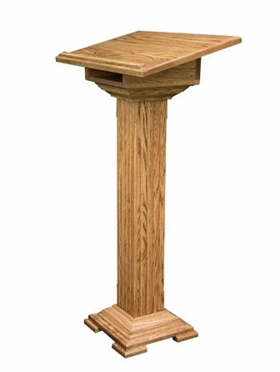
Practice Your Learning
Planning a
½ Day Team Training
Notes:
Same groups
Hand out good behaviour slips
2 minutes: Prepare for the discussion by imagining how you will play your role.
5 minutes: Planning a community garden

Slide 7
How did that go?
Notes:
Same groups
Hand out good behaviour slips
2 minutes: Prepare for the discussion by imagining how you will play your role.
5 minutes: Planning a community garden

Slide 8
O
Notes:
Any questions or comments?

